Slide 1
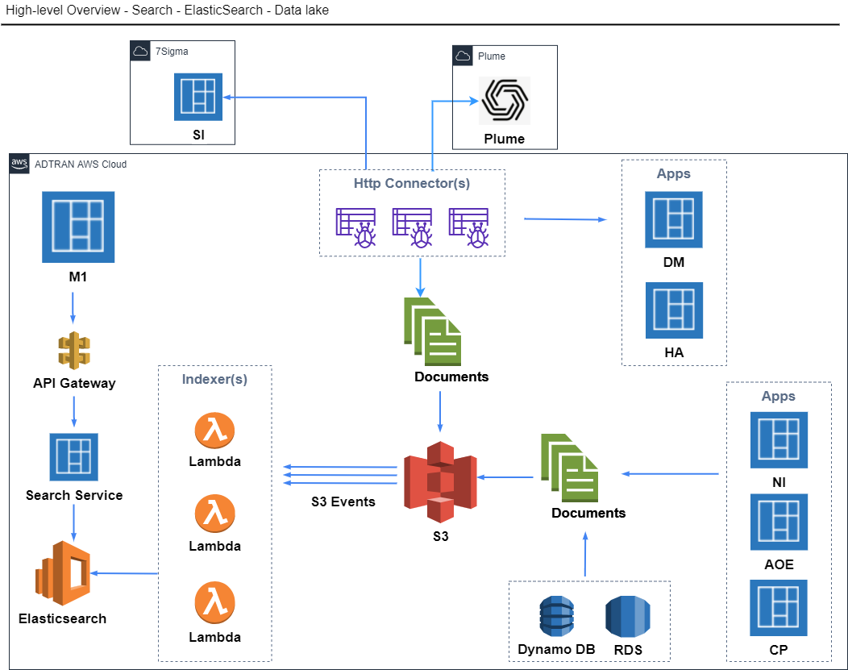
Search Service Architecture

Slide 2
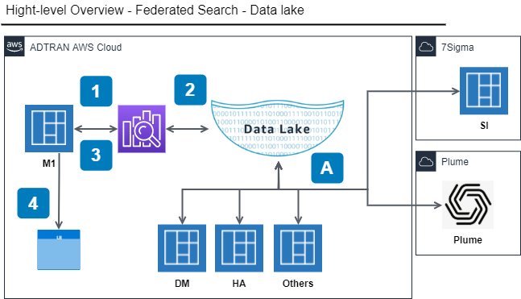
Federated Search Architecture

Slide 3
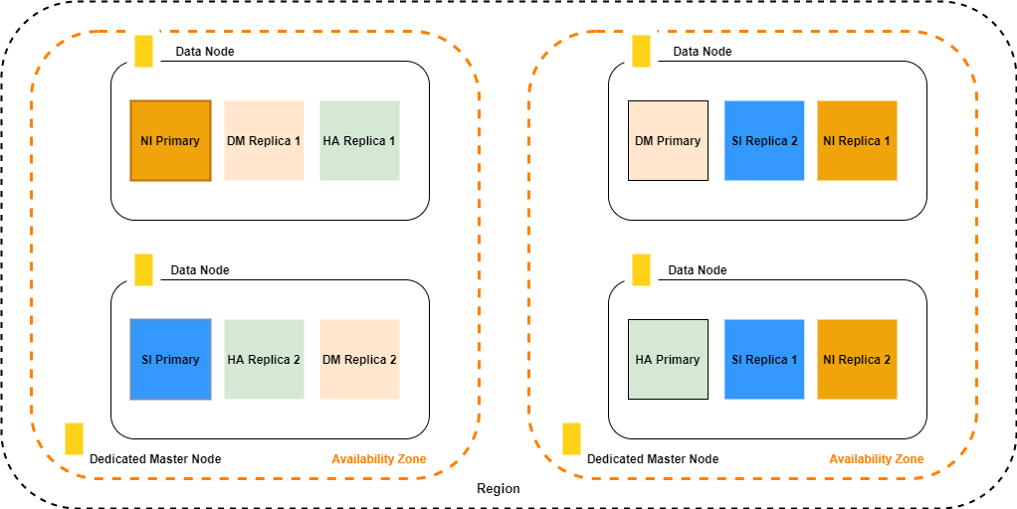
Search Service Domain Configuration

Slide 4
Search Service Domain Configuration

Slide 5
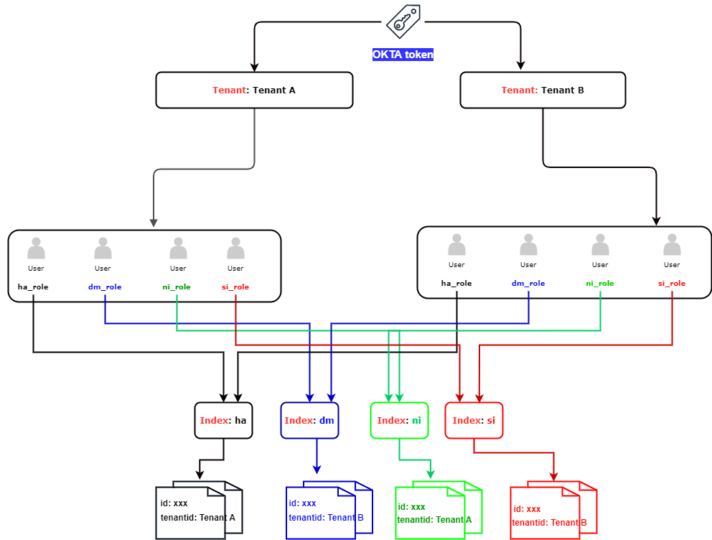
Index Configuration - Multitenancy

Slide 6
Index Configuration - Multitenancy
Value | Minimum Requirement
Domain Name | https://search-adtran-m1-es-poc-2bjxj5bwpnzjkfn64omrpf7zvu.us-east-1.es.amazonaws.com
Instance Type | m4.large.elasticsearch
No. of Nodes | 3
EBS volume for each data node | 10 GiB Magnetic disk
Allow Anonymous Access | No
Availability Zones/Deployment type | 1-AZ
Replicas | 2
Shards | 4
Elasticsearch version | 7.10
rest.action.multi.allow_explicit_index | False
indices.fielddata.cache.size | 40%
indices.query.bool.max_clause_count | 1,024
Network configuration | Public access
Subnet | 1
IAM role | default
Monitoring | Optional
Alerting | Optional
Fine-grained access control | user/password

Slide 7
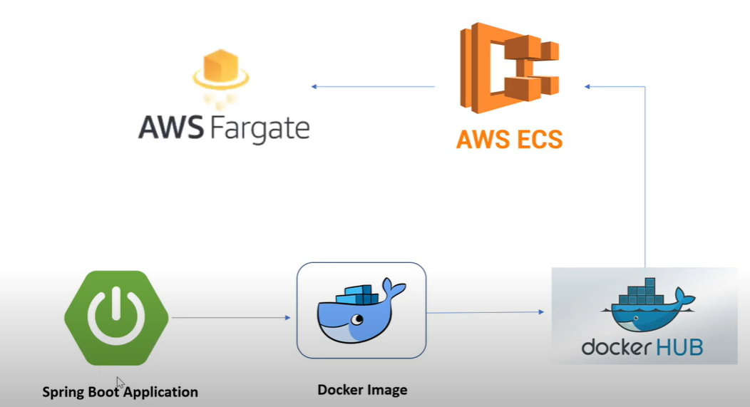
ECS - Search Service Deployment

Slide 8
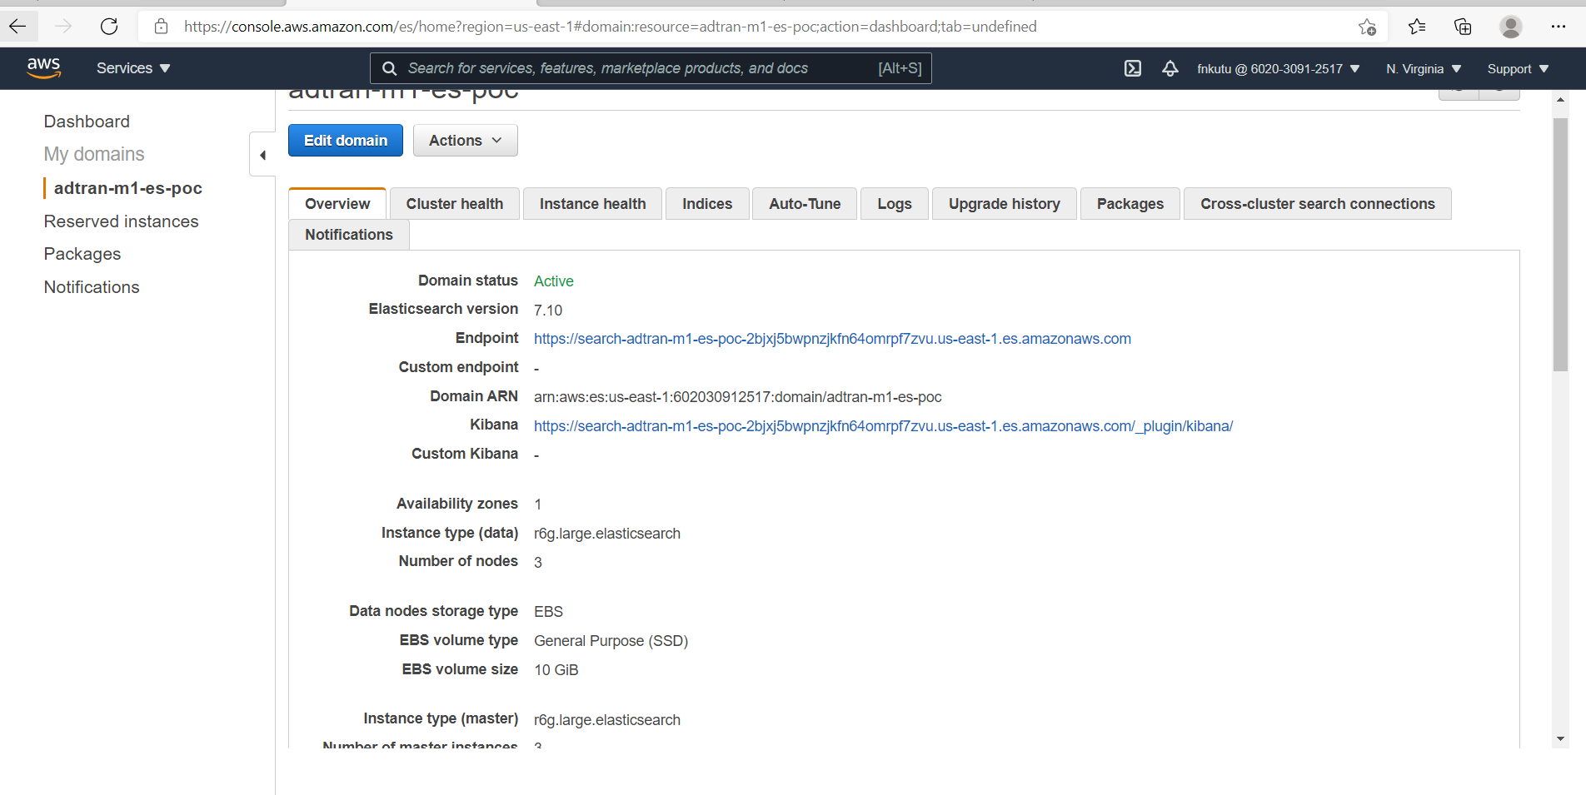
ECS - Search Service Deployment

Slide 9
ECS - Search Service Deployment

Slide 10
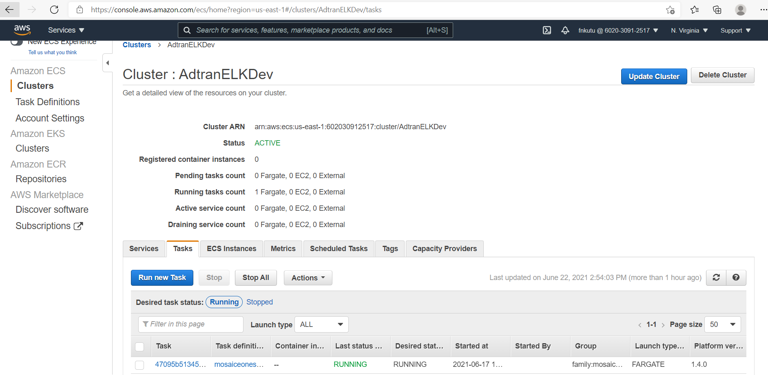
Search Service Code

